Slide 1

Week 5 – Lecture Notes
Pattern recognition - Knowledge discovery

Slide 2
Introduction
Are my customers different?

Slide 3




Introduction
Data Clustering is “to retrieve similar things directly”.
“IBM wants to find companies that are similar to their best business customers, in order to have the sales staff look at them as prospects.”
“Hewlett-Packard maintains many high-performance servers for clients, which are aided by a tool that, given a server configuration, retrieves information on other similarly configured servers.”
What does “similar” mean here?
Why “similar” is needed?

Slide 4
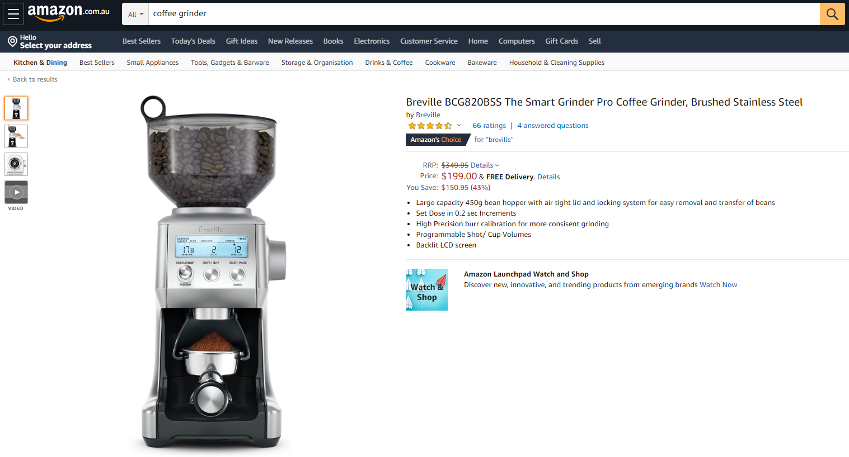
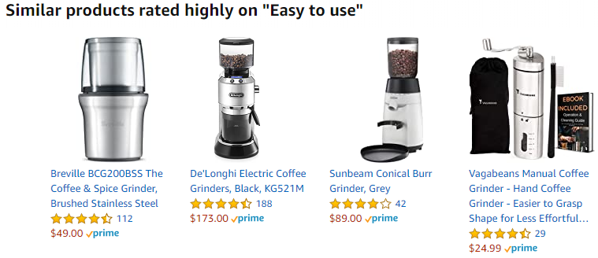
When searching items on Amazon or other shopping websites, some ‘similar’ or ‘relevant’ items are recommended. How do they automatically find these ‘similar’ items for recommendation?

Slide 5


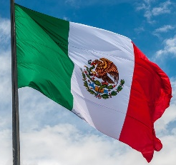

Introduction
A textile factory wants to produce as many national flags as possible in the shortest time with the fewest materials possible.
There are around 200 national flags in different colours and shapes.
How can they reduce costs and production time while maintaining quality and volume?
Hey, I find many flags are using the same red colour!
And the national flags of Italy, Ireland and Mexico are using a similar shape!
Italy
Ireland
Mexico

Slide 6
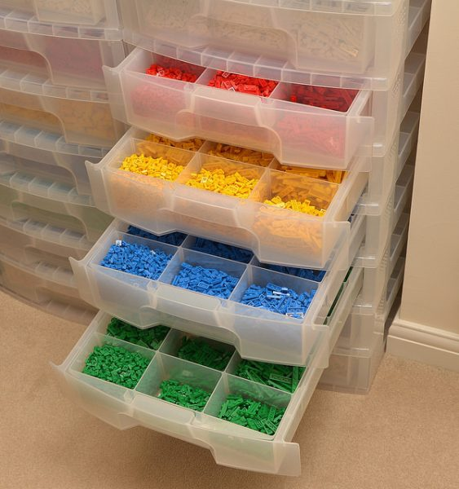
What is Data Clustering?
“Put your Lego back!“

Slide 7
What is Data Clustering?
Data Clustering, in general, is the grouping of objects (clustering) that are similar (or related) to one another and different from (or unrelated to) the objects in other groups.
Intra-cluster distances are minimised
Inter-cluster distances are maximised

Slide 8
What is Data Clustering?
As demonstrated in the following figure, the easiest way to cluster nodes is by measuring the distance between the nodes. Nodes are clustered into the same group if they are physically close to each other.
How do we measure this distance?

Slide 9
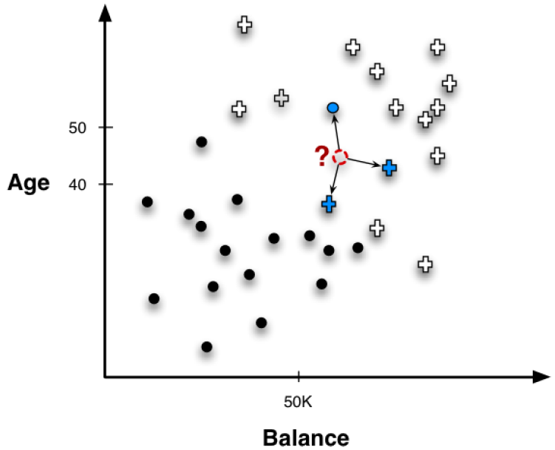
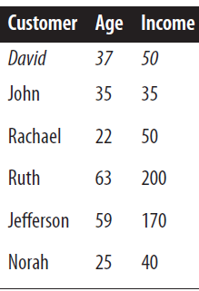
What is Data Clustering?
The most common method to measure distance between items is called Euclidean distance. To avoid technical terms, we can simply consider it as the physical distance between items and call it distance.
Jefferson
Ruth
David
John
Norah
Rachael
100
Income

Slide 10
What is Data Clustering?
How do we measure the distance between David and Jefferson?
Jefferson
(59, 170)
???
A
C
B
David
(37, 50)
100
Income
Notes:
According to the Pythagorean Theorem:
A² =B² × C²
and based on our data:
B = 170 – 50
C = 59 – 37
So we can get:
A = $\sqrt{\left(170−50\right)2+\left(59−37\right)2}=$122

Slide 11
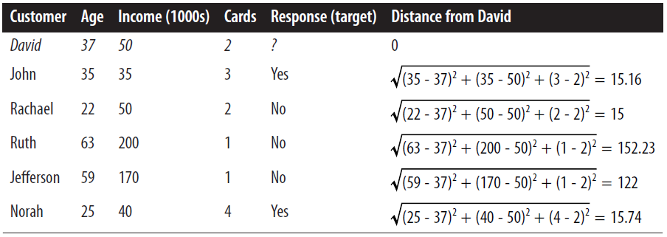
What is Data Clustering?
Now, if David is a new customer, can we predict how he would behave?
100
Income
According to the distances between David and other existing customers, we can find he is similar to John, Rachael and Norah.
It is reasonable to group David into the same cluster as them. Meanwhile, Ruth and Jefferson would be in another cluster.

Slide 12
Data Clustering Methods
Hierarchical clustering and K-Means clustering

Slide 13
Hierarchical Clustering
A
Different hierarchical clustering methods will generate different clustering results.
B

Slide 14
K-means Clustering
Given a value of k, the k-means cluster approach randomly partitions the observations into k clusters.
After all observations have been assigned to a cluster, the resulting cluster centroids are calculated.
Using the updated cluster centroids, all observations are reassigned to the cluster with the closest centroid.

Slide 15
K-means Clustering
Let us see how K-means clustering works.
Step 1: Start with K initial cluster centres.
Step 2: Cluster all nodes/instances to the closest centre.
Step 3: Relocate the centres as the mean of the points in a cluster.
  Repeat Steps 2 and 3 until the centres no longer move.

Slide 16
Visualising K-means Clustering
1. Suppose these nodes represent our data.
2. Randomly put 3 centres (squares) in the data plot.
3. Colour our data in the same as the closest centres.
4. Relocate the centres according to the existing clusters.
Notice the three centres have moved

Slide 17
Visualising K-means Clustering
5. Re-colour the data to the same as the closest centres.
6. Re-locate the centres again
7. Re-colour the data again.
8. Re-locate the centres again.

Slide 18
Visualising K-means Clustering
Until the last time re-locating the centres, we found the nodes’ colour will not be changed based on the closest centres.
Now we can consider the three clusters are ‘stable’ and the clustering process has been completed.

Slide 19
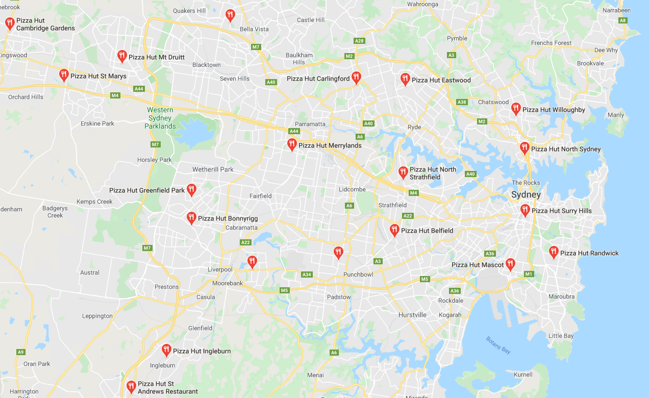
K-means Clustering in Reality
These are all the Pizza Hut restaurants in Sydney. If three delivery centres were to be built in Sydney, where do you think they should be located?
Notes:
These are all the Pizza hut restaurants in Sydney area. If three delivery centers to be built in Sydney, where do you think they should be located?

Slide 20
K-means vs. Hierarchical Clustering
Hierarchical clustering is suitable for a small dataset (e.g. less than 500 observations) and examining solutions with increasing numbers of clusters. It is easy to observe how clusters are nested.
K-means clustering is suitable for a larger dataset and usually the user knows how many clusters are needed.

Slide 21
Conclusion and Notes
This week helps you understand what data clustering is and how to use it in RapidMiner.
You are not required to use MS Excel in this course.
The content of this week is related to Assignment 2.

Slide 22
Additional Reading
The following reading is not compulsory and will not be included in any assignment

Slide 23
Unsupervised Learning
Unsupervised learning application
  The goal is to use the variable values to identify relationships between observations.
  Qualitative assessments, such as how well the results match expert judgment, are used to assess unsupervised learning methods.

Slide 24
Notion of a Cluster can be Ambiguous
How many clusters are there?
Six Clusters
Two Clusters
Four Clusters

Slide 25
How to Interpret Data Instance
Extra example:
KTC is a financial advisory company that provides personalised financial advice to its clients.
KTC would like to segment its customers into several groups (or clusters) so that the customers within a group are similar with respect to key characteristics and dissimilar to customers that are not in the group.

Slide 26
How to Interpret Data Instance
For each customer, KTC has a corresponding vector of measurements on seven customer variables:
Age | Age of the customer in whole years
Female | 1 if female, 0 if male
Income | Annual income in dollars
Married | 1 if married, 0 if not
Children | number of children
Car Loan | 1 if customer has a car loan, 0 if not
Mortgage | 1 if customer has a mortgage, 0 if not

Slide 27
How to Interpret Data Instance
  The data instance u = (61, 0, 57881, 1, 2, 0, 0) can be interpreted as:
  “a 61-year-old male with an annual income of $57,881, married with two children, but no car loan and no mortgage.”

